Slide 1
Analysis and prediction of bus dwell times and bus demand in case of special events
Student: Luca Furlanetto
s161890
Supervisor: Francisco C. Pereira
17 August 2018

Slide 2
Agenda
Motivation
Data presentation
Explanatory analysis
Predictive modelling

Slide 3
Motivations
Increment of population in the cities.
Increment of public transport demand causing more frequent delays and overcrowding situations.
Special events may cause delays and overcrowding situations.
The public transport provider is interested in understanding the causes of abnormal demand situations in order to provide a better service.
Analyze the demand of public transport and bus dwell time in relation of special events in Copenhagen.
Develop prediction models to evaluate the predictability of the demand and dwell times and to determine the relevant features.

Slide 4
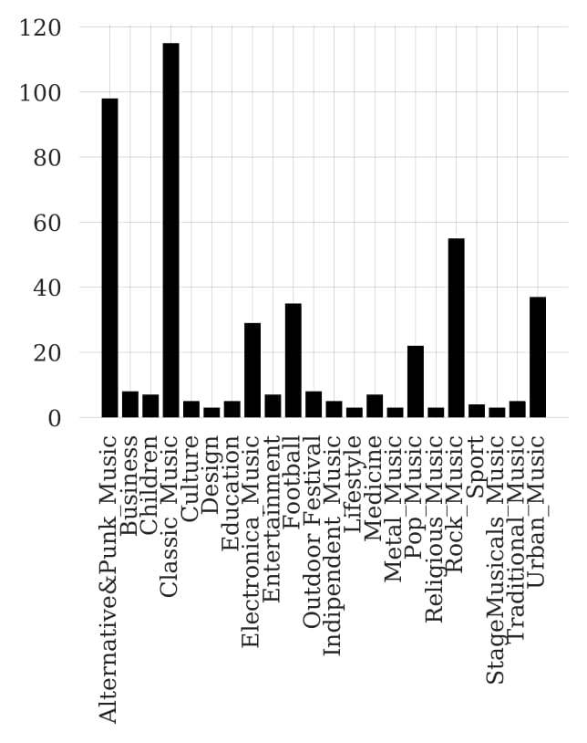


Data presentation
Period: 12 months; 2017.
Locations: six main venues of Copenhagen:
DR Koncerthuset; Royal Arena; Vega;
Bella Center; Forum Copenhagen; Telia Parken.
Provider of bus data: Movia.
Rejsekort data of number of passengers alighting and boarding.
Dwell time data: difference between arrival time and departure time.
Event data :
All the events are divided in group based on the event topic.
Weather : Precipitation and temperature of every day in 2017.

Slide 5

Bus service demand
Rejsekort check in (passengers boarding) check out (passengers alighting);
Passengers using other kind of ticket are not included (26% of passengers use Rejsekort).
An observation indicates the time (intervals of 30 minutes), stop, number of passengers.
Total observation are more than 600,000.
Dwell times
Bus stop length.
An observation indicates arrival and departure time, dwell time, stop number, timing stop.
Total observation are more than 700,000.

Slide 6
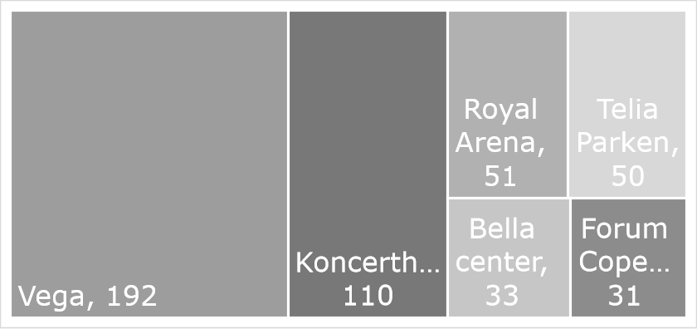
Event data
Indication of the occurrence of events.
Each observation indicates:
staring and ending time, venue, event description.
All the events are divided in group based on the event topic.
467 events.
Weather data
Precipitation and temperature of every day in 2017.

Slide 7








Input features – Target variables
Time of the day
Demand
Event proximity
Weather
Event topic
Dwell times
Time series

Slide 8
Input features – Target variables
Time of the day
Morning , Afternoon, night.
From 3 hours before to 3hours after the starting time. Or, from 3 hours before to 3 hours after the ending time.
Event proximity
Weather
Precipitation (mm), Temperature ( °C).
Event topic
Concert, Football match, exhibition etc..
Time series
The observations recorded previously.

Slide 9
Explanatory analysis Public transport demand

Slide 10
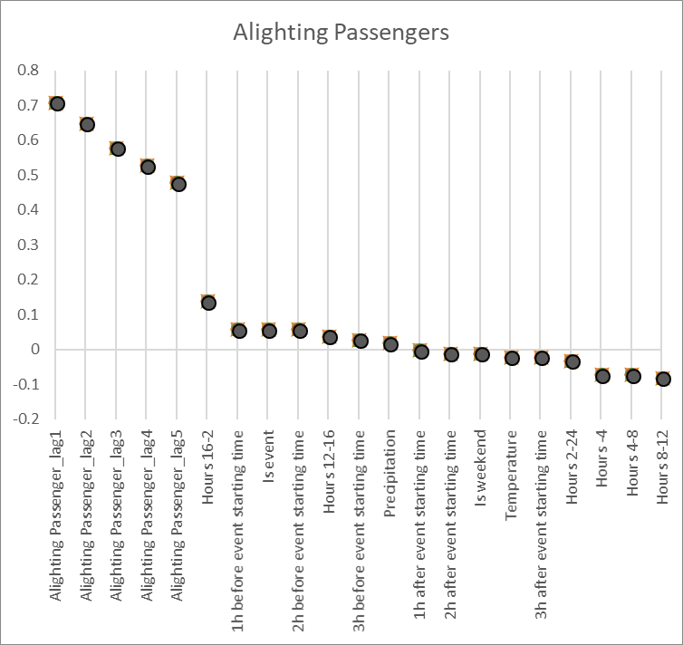
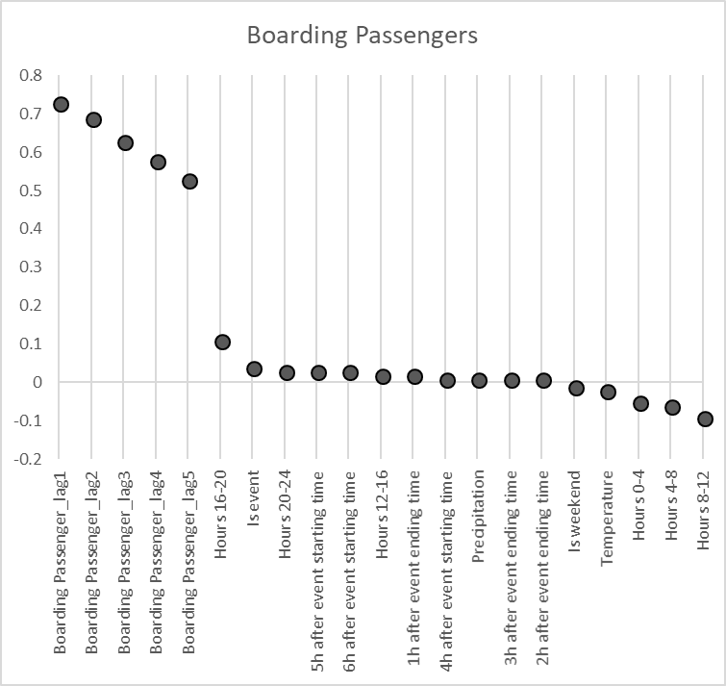
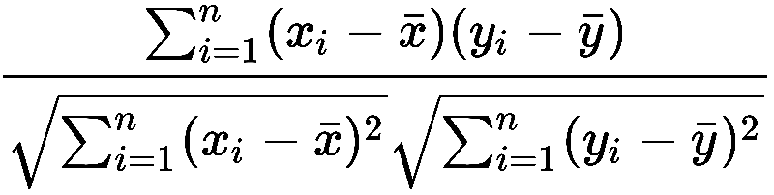
Correlation analysis
Alighting Passengers
Boarding Passengers
Measure and compare the relation between the input variables and the target variables.
Formula:

Slide 11

Correlation analysis Time series
Alighting Passengers
Boarding Passengers
Time series features are the most correlated ones varying from 0.48 to 0.73.

Slide 12
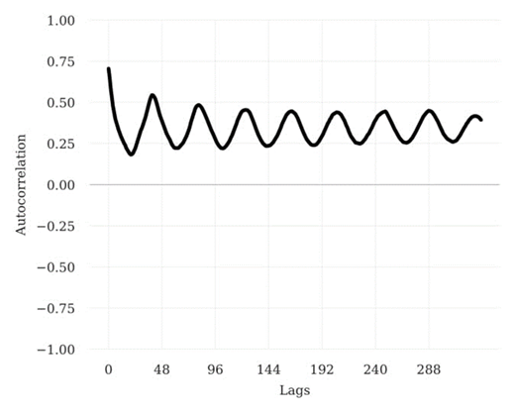
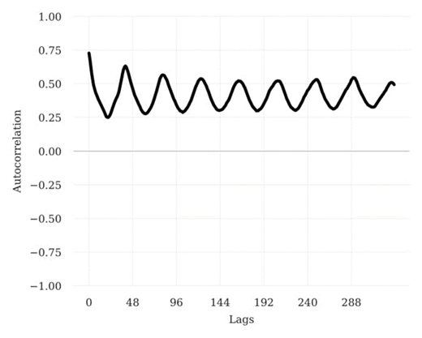
Correlation analysis Autocorrelation
Alighting Passengers
Boarding Passengers
Autocorrelation expresses the degree of similarity of a time series.
Daily repeating pattern.
An observation is more related with the one occurred 24h before rather than the one occurred 12h before.

Slide 13

Correlation analysis Time of the day, Event proximity, Weather
Alighting Passengers
Boarding Passengers
Time of the day, Event proximity, Weather obtained lower correlation values.

Slide 14
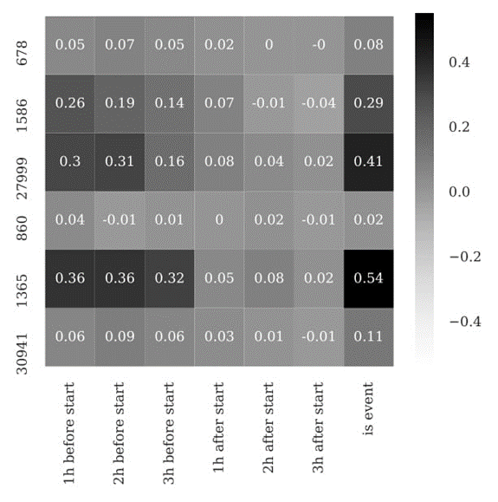
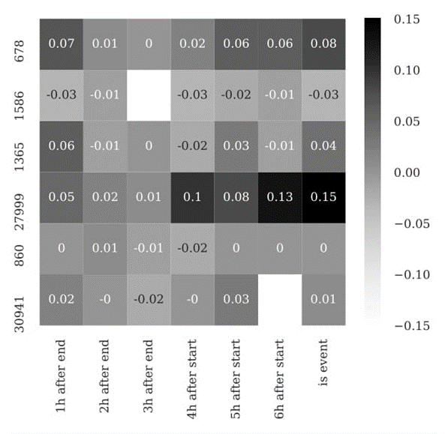
Correlation analysis Event proximity
Alighting Passengers
Boarding Passengers
Forum
Vega
Bella C
Koncert.
Telia P.
Royal A.
Event proximity correlation for each stop divided by hour.
The demand in Bella center is highly correlated with events.
Only for passengers alighting, the demand in Telia Parken and Vega is highly correlated with events.
Forum
Vega
Telia P.
Bella C
Koncert.
Royal A.

Slide 15
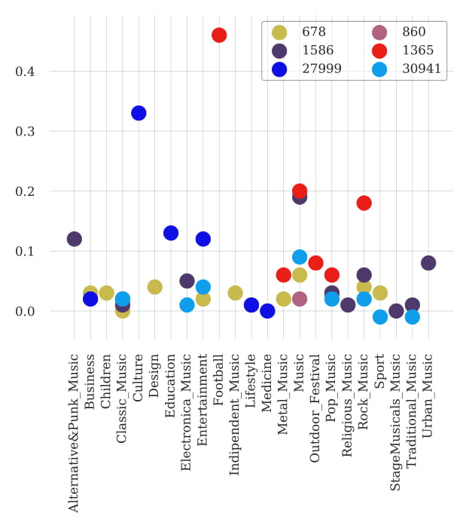
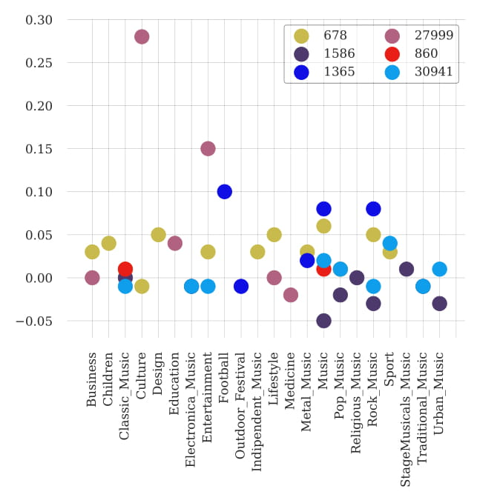
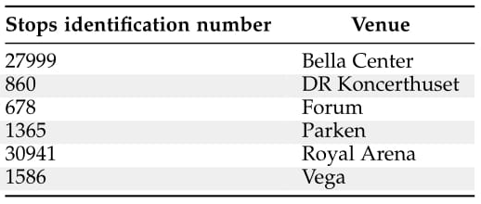
Correlation analysis Event topics
Alighting Passengers
Boarding Passengers
Event topics correlation for each stop.
Cultural event influence more than others the demand in Bella Center.
Football match influence more than others the demand (alighting) in Telia Parken.

Slide 16
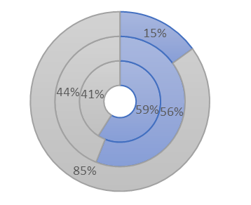
Abnormal observations Considering the quantiles
Is there a relation between event and the highest demand observation?
How many of the highest demand observation occurred in proximity of events?
To determine the highest observation the 98th and the 99th quantile have been calculated
HIGHEST
99TH QUANTILE
98TH QUANTILE
How many observations are occurred in proximity of event considering:
The entire dataset
The observations over the 98th quantile
The observations over the 99th quantile
LOWEST

Slide 17
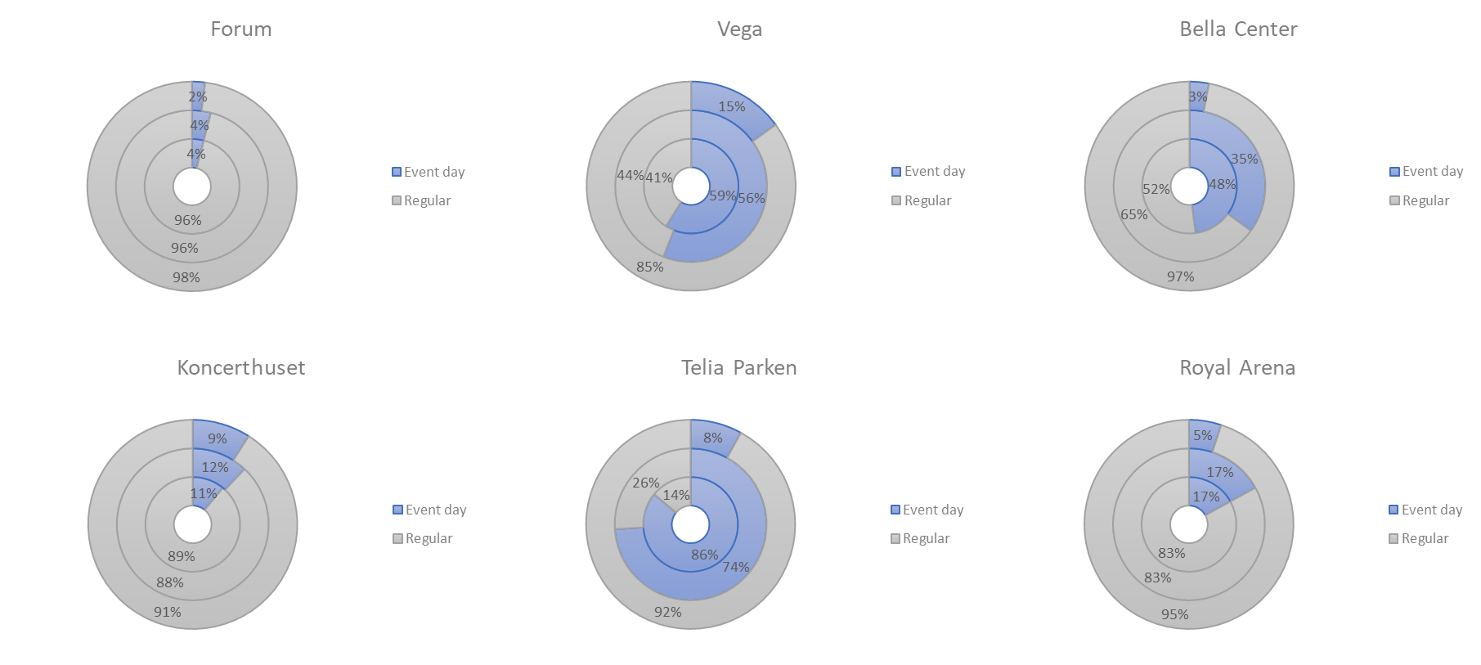
Abnormal observations Passengers alighting

Slide 18
Abnormal observations Passengers alighting

Slide 19
Abnormal observations Passengers alighting
* In this case the 98th and 99th quantile are close to the average and therefore and not “abnormal”

Slide 20
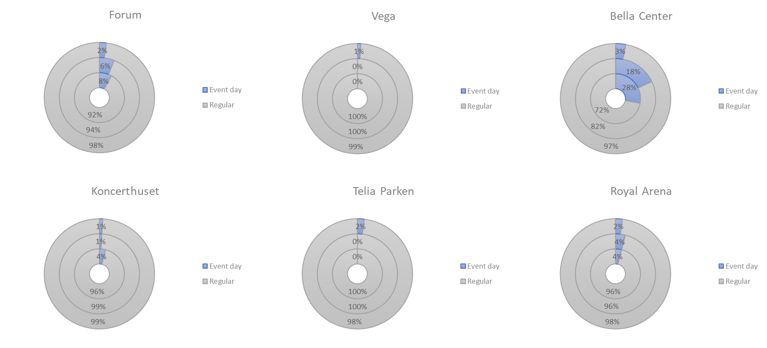
Abnormal observations Passengers boarding
* In this case the 98th and 99th quantile are close to the average and therefore and not “abnormal”

Slide 21
Explanatory analysis Bus dwell times

Slide 22
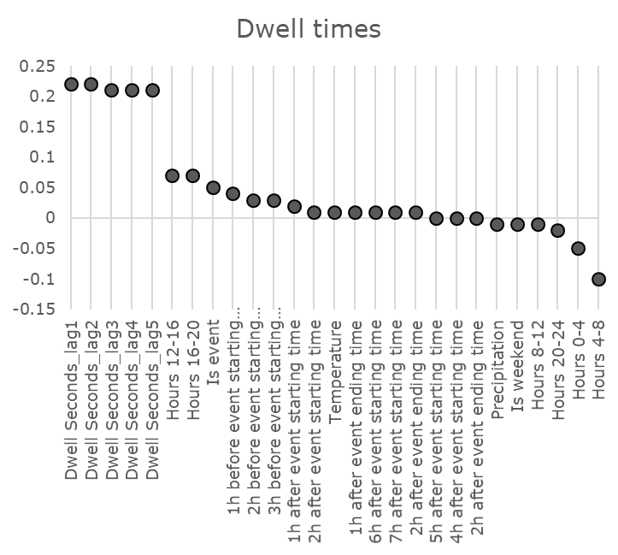
Correlation analysis

Slide 23
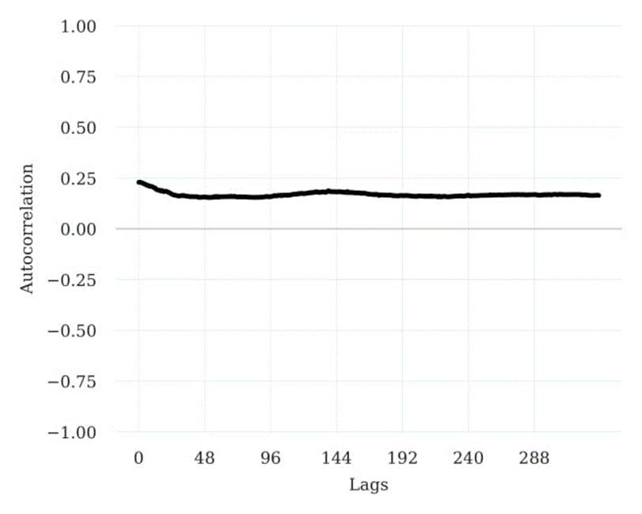
Correlation analysis Autocorrelation
Time series are the most correlated features with the dwell time.
Absence of repeating patterns, the closest observations are the most similar.

Slide 24
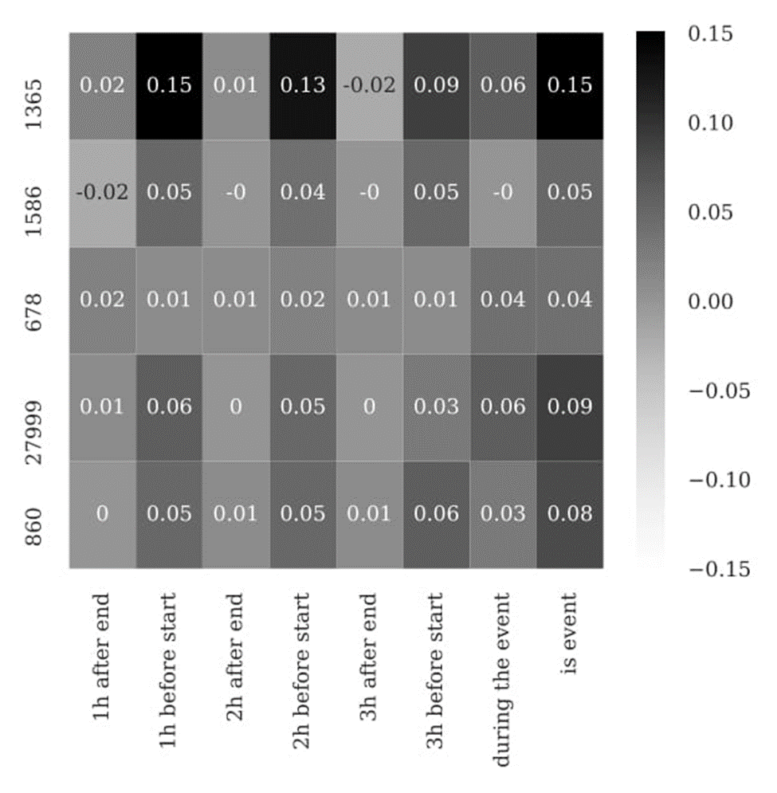
Correlation analysis Event proximity
Telia P.
Vega
Forum
Bella C.
Koncert.
Telia Parken is the only location where the correlation between event and dwell time is relevant.
In all the other cases, events do not have a relevant effect on the dwell time.

Slide 25
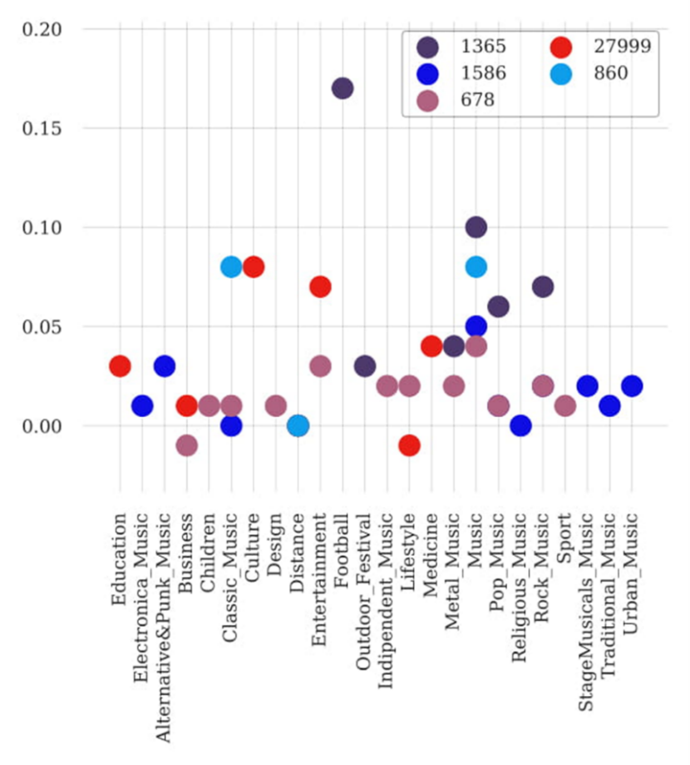
Correlation analysis Event topic
The results obtained considering the topic of the events are not different from the previous.
Dwell time in Telia Parken is more influenced by football related events than others type of events.

Slide 26
Abnormal observations Considering the quantiles
Is there a relation between event and the longest dwell time observations?
How many of the highest observation occurred in proximity of events?
To determine the highest observation the 98th and the 99th quantile have been calculated.
HIGHEST
99TH QUANTILE
98TH QUANTILE
How many observations are occurred in proximity of event considering:
The entire dataset
The observations over the 98th quantile
The observations over the 99th quantile
LOWEST

Slide 27
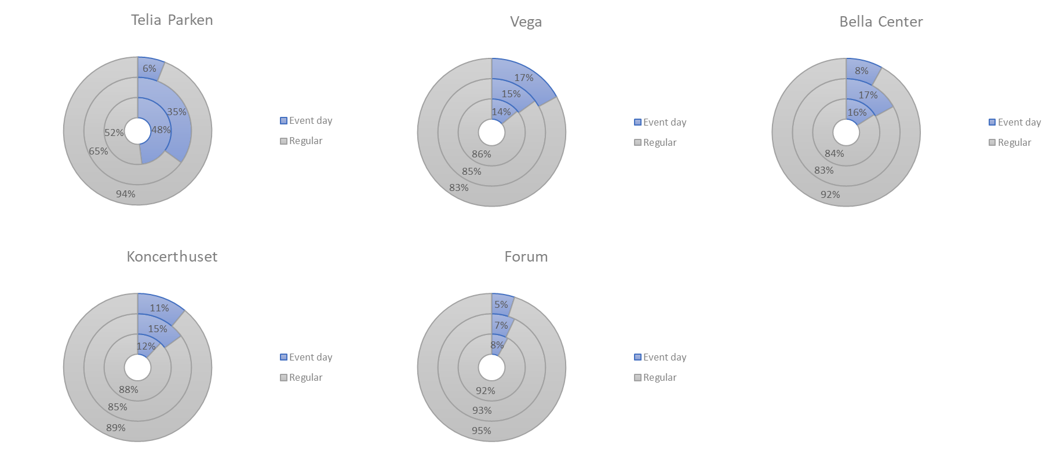
Abnormal observations

Slide 28
Abnormal observations

Slide 29
Abnormal observations

Slide 30
Predictive modelling

Slide 31

Models description
Historical average:
Mean of all the past data.
Linear regression:
Estimation of the input features coefficient minimizing the residuals (Ordinary Least Squared Error).
Bayesian linear regression:
Differently from the Linear regression, the distributions of the coefficients are estimated and the target variable is assumed to be normally distributed with the product of the input variables as mean.

Slide 32
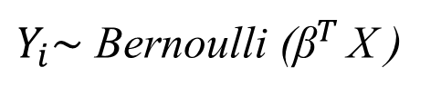
Models description
Gaussian Process:
It express the probability distribution over all the possible functions that are consistent with the observations.
Support vector machine classifier:
It plots on a n-dimensional space (n=number of input features) the observation and finds the hyper-plane that best differentiate the two classes.
Bayesian classifier:
the entire distributions of the coefficients are estimated and the target variable is assumed to have a Bernoulli distribution (2 classes).
$Y_{i}\sim$ Bernoulli (${\text{β}}^{T }$X )

Slide 33
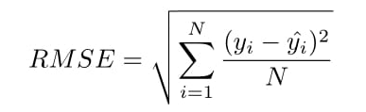

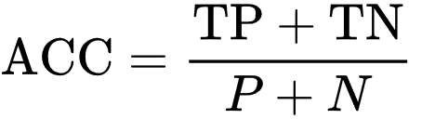
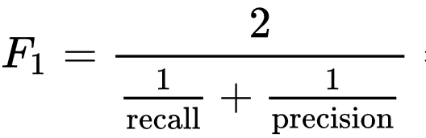
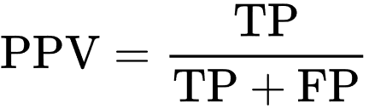
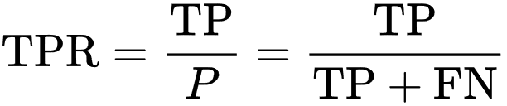
Evaluation Criteria
Root mean squared error (RMSE):
Divergence between the real observation and the prediction.
R-squared:
Proportion of the real variance explained by the prediction.
Accuracy:
Proportion of observation predicted correctly.
F1 score:
Harmonica Average of Precision and Recall.
Precision: What proportion of positive identifications was actually correct?
Recall: What proportion of actual positives was identified correctly?

Slide 34
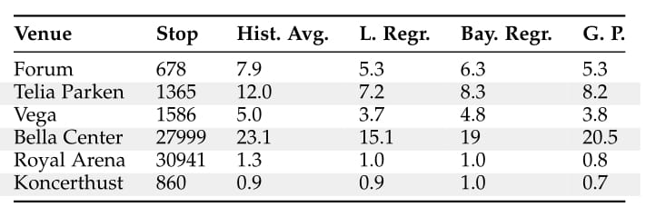
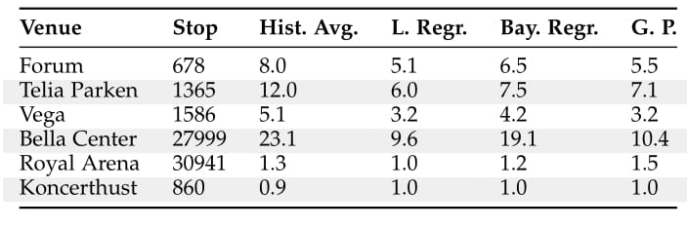
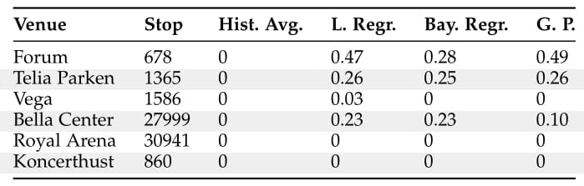
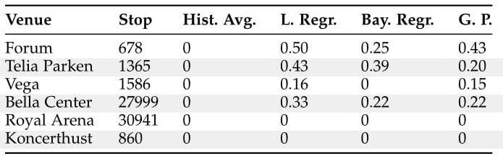
Results Passengers alighting
Excluding event information
Including event information
RMSE
R-squared

Slide 35

Results Passengers alighting
Excluding event information
Including event information
RMSE
The models outperform the baseline.
R-squared

Slide 36


Results Passengers alighting
Excluding event information
Including event information
RMSE
In all the cases, considering event information improve the models’ performances.
R-squared

Slide 37



Results Passengers alighting
Excluding event information
Including event information
RMSE
Regarding the two location: Royal Arena and Koncerthuset the prediction models are not capable to provide a reliable prediction.
R-squared

Slide 38
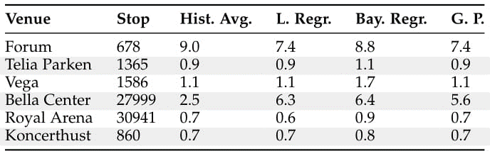
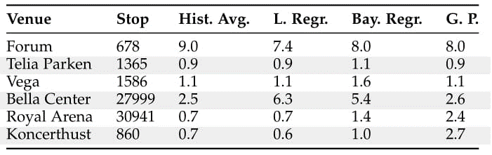
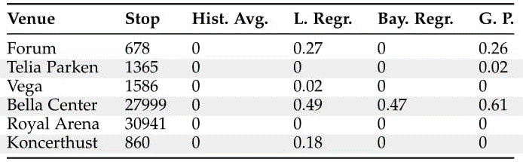
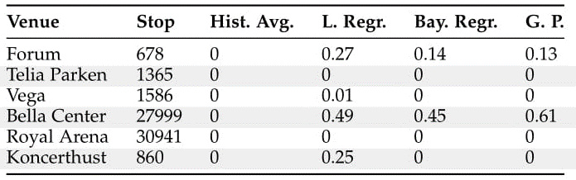
Results Passengers boarding
Excluding event information
Including event information
RMSE
R-squared

Slide 39
Results Passengers boarding
Excluding event information
Including event information
RMSE
Only in one case (Forum) the models perform better than the baseline.
In all the other case the performance are similar meaning a low correlation between the observations of passengers boarding and the input features.
R-squared

Slide 40
Results Passengers boarding
Excluding event information
Including event information
RMSE
Only in few cases (Forum and Koncerthuset) event information help improving the quality of the forecast confirming a low correlation between passengers alighting and event occurrence.
R-squared

Slide 41
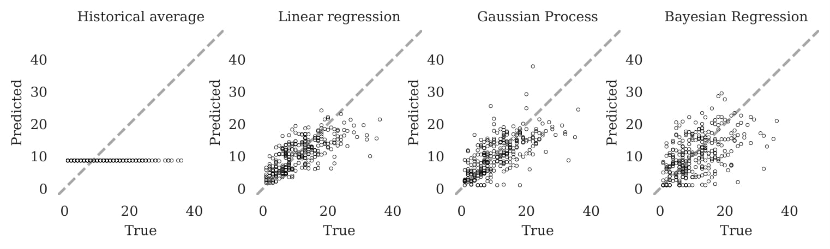
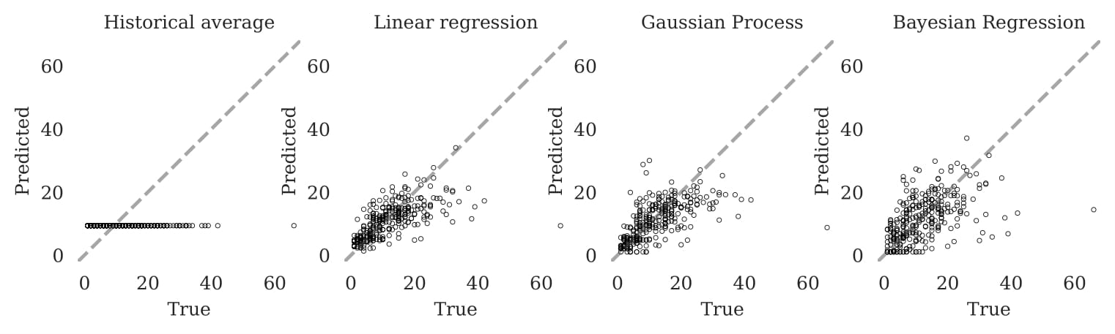
Results Models comparison
Passengers Alighting
This graphs represent a comparison between the true values (X-axis) and the prediction (Y-axis). The data refers to the venue Forum considering event information.
Generally, the models that work better are Linear Regression and Gaussian Process.
Passengers Boarding

Slide 42
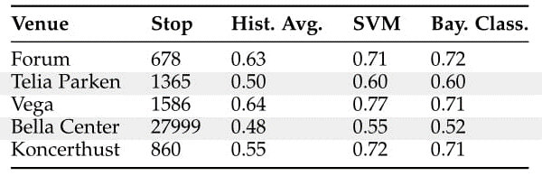
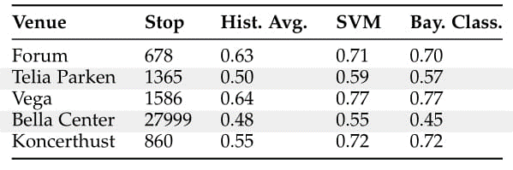
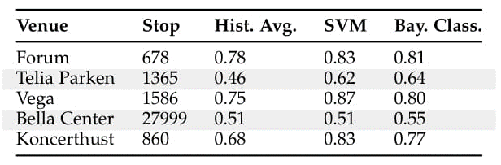
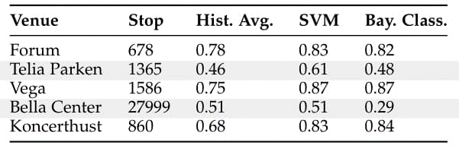
Results Dwell times - Stopping
Excluding event information
Including event information
Accuracy
F1 score

Slide 43
Results Dwell times - Stopping
Excluding event information
Including event information
Accuracy
The models always perform better than the baseline meaning , it is possible with a good approximation predicting if the bus is stopping or not.
F1 score

Slide 44
Results Dwell times - Stopping
Excluding event information
Including event information
Accuracy
Event information do not improve the prediction quality. Meaning a low correlation with events.
F1 score

Slide 45
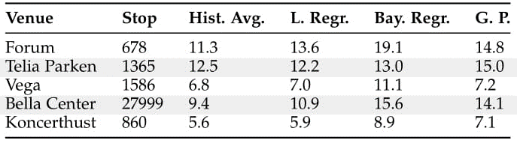
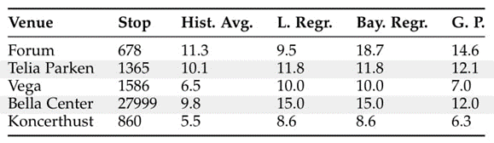
Results Dwell times
Excluding event information
Including event information
RMSE
R-squared values are always equal to zero meaning that the models are not able to express any of the variance of the real observation.

Slide 46
Results Dwell times
Excluding event information
Including event information
RMSE
Only in case of the locations Forum and Telia Parken the models outperform the baseline.

Slide 47
Results Dwell times
Excluding event information
Including event information
RMSE
Only in case of Forum, Telia Parken, Vega the model performances improved considering events information.

Slide 48
Possible further works
Considers not only the number of passengers alighting and boarding but the exact number of passengers in the bus to understand if the bus capacity is exceed.
Use prediction of demand to estimate dwell times.
Data regarding train and metro demand should be considered in particular for those venues close to metro and trains stations (Forum, Bella Center, Royal Arena).
Consider traffic data since event participants use different means of transports.

Slide 49
Thanks for your attention

